Slide 1
FIFA World Cup Database
Thomas Germon, Kevin Huynh, Patrick Schofield

Slide 2

Introduction
This project aims to represent the results and partial statistics about the 2018 FIFA World Cup that took place in Russia. While deciding on the project we decided to specifically deal with the 2018 season so that we would be able to focus on more in-depth statistics while maintaining a clean and easy to understand database.
When dealing with the Cup, we decided to split our database in 10 tables, with each table representing an entity. With 3-8 data elements in each, the tables have a primary and foreign key in each to attach and cross-connect to different related tables to make queries easier.

Slide 3
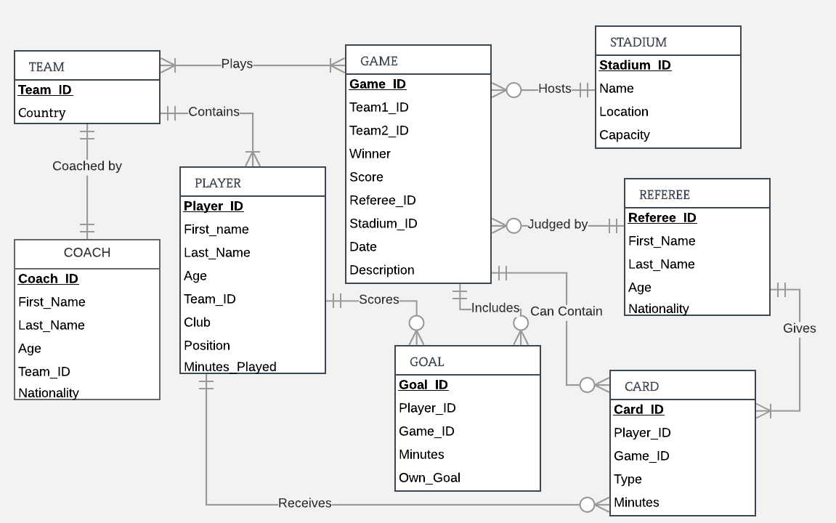
Entity Relationship Diagram

Slide 4
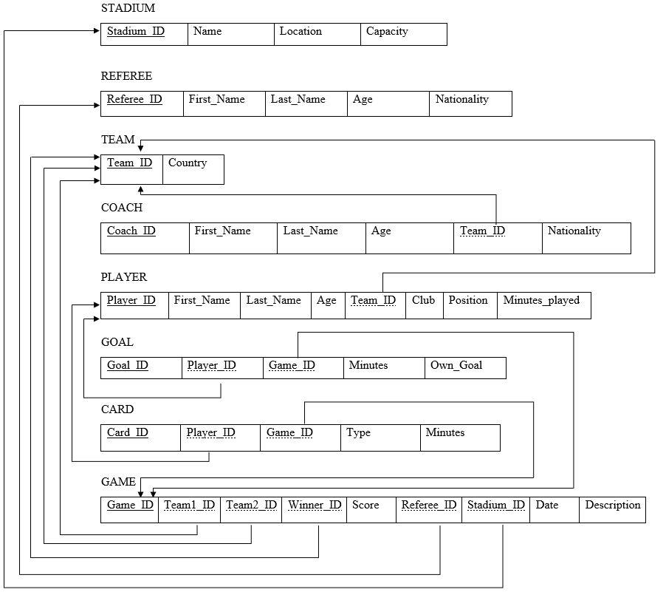
RELATIONAL MODEL

Slide 5
CREATE and INSERT Examples
INSERT INTO Player VALUES(1, 'Hugo', 'Lloris', 31, 11, 'Tottenham', 'Goalkeeper', 540);
INSERT INTO Player VALUES(2, 'Steve', 'Mandanda', 33, 11, 'Olympique de Marseille', 'Goalkeeper', 90);
INSERT INTO Player VALUES(3, 'Alphonse', 'Areola', 25, 11, 'Paris Saint Germain', 'Goalkeeper', 0);
INSERT INTO Player VALUES(4, 'Rapahel', 'Varane', 25, 11, 'Real Madrid', 'Defender', 630);
INSERT INTO Player VALUES(5, 'Lucas', 'Hernandez', 22, 11, 'Atletico Madrid', 'Defender', 589);
INSERT INTO Player VALUES(6, 'Samuel', 'Umtiti', 24, 11, 'Barcelona FC', 'Defender', 540);
INSERT INTO Player VALUES(7, 'Benjamin', 'Pavard', 22, 11, 'VfB Stuttgart', 'Defender', 540);
INSERT INTO Player VALUES(8, 'Djibril', 'Sidibe', 25, 11, 'AS Monaco', 'Defender', 90);
INSERT INTO Player VALUES(9, 'Presnel', 'Kimpembe', 22, 11, 'Paris Saint Germain', 'Defender', 90);
INSERT INTO Player VALUES(10, 'Benjamin', 'Mendy', 24, 11, 'Manchester City', 'Defender', 41);
INSERT INTO Player VALUES(11, 'Adil', 'Rami', 32, 11, 'Olympique de Marseille', 'Defender', 0);
INSERT INTO Player VALUES(12, 'Ngolo', 'Kanté', 27, 11, 'Chealsea', 'Midfielder', 594);
CREATE TABLE Player (
Player_ID INT NOT NULL PRIMARY KEY,
First_Name VARCHAR(30),
Last_Name VARCHAR(30),
Age INT,
Team_ID INT,
Club VARCHAR(30),
Position VARCHAR(30),
Minutes_Played INT,
CONSTRAINT FK_Player_Team_ID FOREIGN KEY (Team_ID) REFERENCES Team(Team_ID)
Notes:
https://docs.google.com/document/d/1eACT5BXVoAslVeiAAlHVwmPI6GgZsiC6ZaqiijHcwM0/edit

Slide 6




Four Simple Queries
(based on lecture 6)
Find the first name and last name of the French coaches
SELECT First_Name, Last_Name FROM Coach WHERE Nationality = 'France';
Find the club of Eden Hazard
SELECT Club FROM Player WHERE First_Name = 'Eden' AND Last_Name = 'Hazard';
Find the first name and last name of American referees
SELECT First_Name, Last_Name FROM Referee WHERE Nationality = 'United States';
Find name and capacity of stadiums in Moscow
SELECT Name, Capacity FROM Stadium WHERE Location = 'Moscow';

Slide 7



Three Intermediate Queries
Based on lecture 7
Find the average age of Croatian team (Team_Id: 7) and name it Average_Age
SELECT Avg(Age) AS Average_Age FROM Player WHERE Team_Id = 7;
Find the id of each game and the number of goals associated and name it as Total_Goals
SELECT Game_Id, Count(Goal_Id) AS Total_Goals FROM Goal GROUP BY Game_Id;
Find the first name, the last name and the age of the youngest players in the world cup
SELECT First_Name, Last_Name, Age AS Min_Age FROM Player WHERE Age = (SELECT Min(Age) FROM Player);

Slide 8
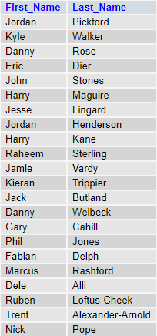

Three Advanced Queries
Based on lecture 8
Find first name and last name of all English players
SELECT p.First_Name, p.Last_Name FROM Player p, Team t WHERE p.Team_Id = t.Team_Id AND t.Country = 'England';
Find the first name, the last name of the player, the team name and the minute of yellow cards during the finals
SELECT p.First_Name, p.Last_Name, t.Country, c.Minute FROM Player p, Team t, Game g, Card c WHERE p.Team_Id = t.Team_Id AND p.Player_Id = c.Player_Id AND c.Game_Id = g.Game_Id AND g.Description = 'Finals';

Slide 9
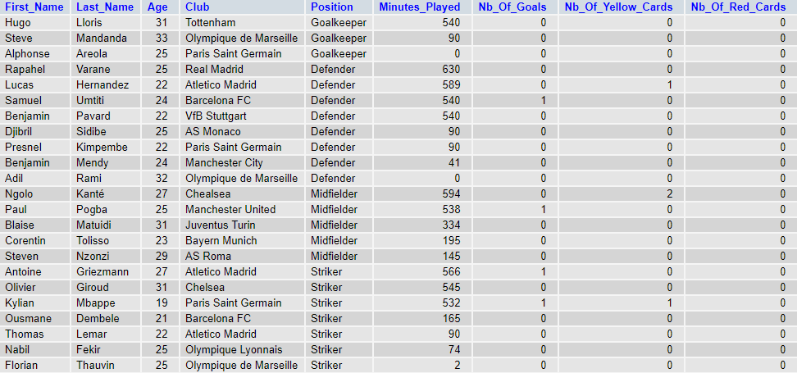
Cont.
Find all the player statistics (first name, last name, age, club, position, minutes played, nb of goal, nb of red card, nb of yellow card) of French players
SELECT p.First_Name, p.Last_Name, p.Age, p.Club, p.Position, p.Minutes_Played, Count(g.Goal_Id) AS Nb_Of_Goals, Count(yc.Card_Id) AS Nb_Of_Yellow_Cards, Count(rc.Card_Id) AS Nb_Of_Red_Cards
FROM Player p
LEFT JOIN Goal g ON p.Player_Id = g.Player_Id AND g.Own_Goal = False
LEFT JOIN Card yc ON p.Player_ID = yc.Player_Id AND yc.Type = 'Yellow'
LEFT Join Card rc ON p.Player_ID = rc.Player_Id AND rc.Type = 'Red'
JOIN Team t ON p.Team_Id = t.Team_ID
WHERE t.Country = 'France'
GROUP BY p.Player_ID;

